Slide 1

CSE- 208
Algorithms Lab
Lab: 12
Graph Algorithm Implementation
Fahad Ahmed
Lecturer, Dept. of CSE
E-mail: fahadahmed@uap-bd.edu

Slide 2
Task-12
Problem:
Implement the following algorithm :
Breadth First Search
Depth First Search
Bipartite Graph

Slide 3


Breadth First Search

Slide 4
BFS and DFS
There are many ways to traverse graphs. BFS and DFS are the most commonly used approach.
BFS is a traversing algorithm where you should start traversing from a selected node (source or starting node) and traverse the graph layer wise thus exploring the neighbor nodes (nodes which are directly connected to source node). You must then move towards the next-level neighbor nodes.
DFS algorithm is a recursive algorithm that uses the idea of backtracking. It involves exhaustive searches of all the nodes by going ahead, if possible, else by backtracking.
Here, the word backtrack means that when you are moving forward and there are no more nodes along the current path, you move backwards on the same path to find nodes to traverse. All the nodes will be visited on the current path till all the unvisited nodes have been traversed after which the next path will be selected.

Slide 5
Breadth First Search
Algorithmic Steps
Step 1: create a Queue. enQueue (Add) the source node in the Queue mark as visited.
Step 2: Loop until the queue is empty.
Step 3: dequeue (Print element, u) the selected node from the Queue.
Step 4: mark and enqueue all (unvisited) neighbours of u

Slide 6
Breadth First Search
Algorithmic Procedure
BFS(G,source):
Q=queue(), level[]={-1}
Q.enqueue(source)
level[source]=0
while Q is not empty
u ← Q.deQueue()
visited[u] = 1
for all edges from u in G.adjacentEdges(u) do
if adj[u][i] == 1 && visited[i] == 0:
level[u]=level[v]+1;
Q.enqueue(i)
end if
end for
end while
Return distance;

Slide 7
Breadth First Search Algorithm
void BFS()
{
int i=0;
for(i=0; i<n; i++)
{
visited[i] = 0;
level[i]=-1;
}
int src, u;
printf("Start Vertex: \n");
scanf("%d", &src);
enQueue(src);
level[src]=0;
while(!isEmpty_queue())
{
u= deQueue( );
if(visited[u])
continue;
printf("%d->",u);
visited[u] = 1;
for(i=0; i<n; i++)
{
if(adj[u][i] == 1 && visited[i] == 0)
{
level[i]=level[u]+1;
enQueue(i);
}
}
}
printf("\n");
}

Slide 8
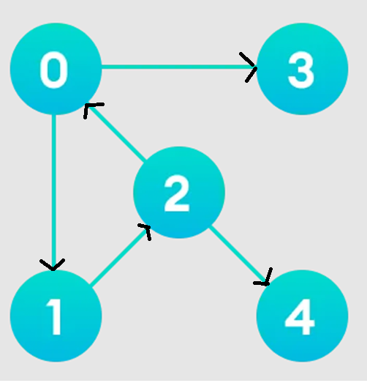
Breadth First Search Algorithm

Slide 9
Breadth First Search Algorithm
Input:
No of vertex: 5
Edges:
0 1
0 3
1 2
2 0
2 4
Source vertex:
0

Slide 10
Breadth First Search Algorithm
Adjacent Matrix:
0 1 0 1 0
0 0 1 0 0
1 0 0 0 1
0 0 0 0 0
0 0 0 0 0

Slide 11
Breadth First Search Algorithm
Input
5
0 1
0 3
1 2
2 0
2 4
-1 -1
Source vertex:
0
BFS Sequence:
0->1->3->2->4
vertex Level
0 0
1 1
2 2
3 1
4 3

Slide 12
Breadth First Search Algorithm
Source vertex:
2
BFS Sequence:
2->0->4->1->3
vertex Level
0 1
1 2
2 0
3 2
4 1

Slide 13
Breadth First Search Algorithm
Source vertex:
3
BFS Sequence:
3->
vertex Level
0 -1
1 -1
2 -1
3 0
4 -1

Slide 14
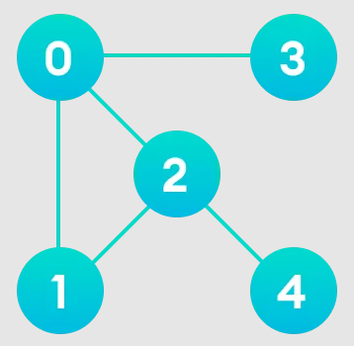
Breadth First Search Algorithm
Adjacent Matrix:
0 1 1 1 0
1 0 1 0 0
1 1 0 0 1
1 0 0 0 0
0 0 1 0 0

Slide 15
Breadth First Search Algorithm
Adjacent Matrix:
0 1 1 1 0
1 0 1 0 0
1 1 0 0 1
1 0 0 0 0
0 0 1 0 0
Source vertex:
0
BFS Sequence:
0->1->2->3->4

Slide 16
Breadth First Search Algorithm
For a directed graph, the sum of the sizes of the adjacency lists of all the nodes is E.
So, the time complexity in this case is
O(V) + O(E) = O(V + E).

Slide 17
Depth First Search (DFS)

Slide 18
Depth First Search (DFS)
Adjacent Matrix:
0 1 0 1 0
0 0 1 0 0
1 0 0 0 1
0 0 0 0 0
0 0 0 0 0
Source vertex:
0
DFS Sequence:
0-> 1-> 2-> 4-> 3

Slide 19
Depth First Search (DFS)
Algorithmic Steps
Step 1: Push the root node in the Stack.
Step 2: Loop until stack is empty.
Step 3: Peek the node of the stack.
Step 4: If the node has unvisited child nodes, get the unvisited child node, mark it as traversed and push it on stack.
Step 5: If the node does not have any unvisited child nodes, pop the node from the stack.

Slide 20
DFS Procedure
DFS-iterative (G, s): //Where G is graph and s is source vertex
let S be stack
S.push( s ) //Inserting s in stack
mark s as visited.
while ( S is not empty):
//Pop a vertex from stack to visit next
v = S.top( )
S.pop( )
//Push all the neighbours of v in stack that are not visited
for all neighbours w of v in Graph G:
if w is not visited :
S.push( w )
mark w as visited

Slide 21
DFS Procedure
void DFS()
{
int i;
for(i=0; i<n; i++)
state[i]=initial;
printf("\nStarting node: ");
int src,u;
scanf("%d",&src);
push(src);
while(!isEmpty_stack())
{
u = pop();
if(state[u]==initial)
{
printf("%d-> ",u);
state[u]=visited;
}
for(i=n-1; i>=0; i--)
{
if(adj[u][i]==1 && state[i]==initial)
push(i);
}
}
}

Slide 22
DFS Vs BFS
BASIS | DFS | BFS
Traversal order | Depth | Level
Data structure Used | Stack | Queue
Time Complexity | O(V + E) | O(V + E)
Space Complexity | O(V) | O(V)
Traversal tree | Narrow and long | Wide and short

Slide 23
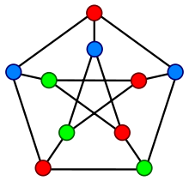
Graph Coloring Problem
Graph coloring problem involves assigning colors to certain elements of a graph subject to certain restrictions and constraints.
In other words, the process of assigning colors to the vertices such that no two adjacent vertexes have the same color is caller Graph Coloring.
This is also known as vertex coloring.

Slide 24
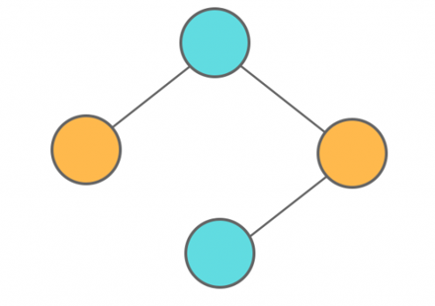
Graph Coloring Problem
Chromatic Number: The smallest number of colours needed to colour a graph G is called its chromatic number.
For example, in the above image, vertices can be coloured using a minimum of 2 colours.
Hence the chromatic number of the graph is 2.

Slide 25
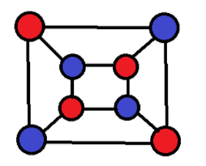
bipartite graph
A bipartite graph, also called a bi-graph, is a set of graph vertices decomposed into two disjoint sets such that no two graph vertices within the same set are adjacent.
A bipartite graph is a special case of a k-partite graph with k=2.
The illustration above shows some bipartite graphs, with vertices in each graph colored based on to which of the two disjoint sets they belong.
Bipartite graphs are equivalent to two-colorable graphs. All acyclic graphs are bipartite.

Slide 26
bipartite graph
To properly color any bipartite graph,
Minimum 2 colors are required.
This ensures that the end vertices of every edge are colored with different colors.
Bipartite graphs contain no odd cycles.
Every sub graph of a bipartite graph is itself bipartite.
If graph is bipartite with no edges, then it is 1-colorable.

Slide 27
bipartite graph
isBipartite(G,src){
Let q be an empty queue
s = src
colour v Red
q.enqueue(s)
while !q.empty()
u = q.dequeue()
for each v in u.adjuptoList:
if v.color is nil:
v.color = (u.color == Red) ? Black : Red
q.enqueue(v)
elif v.color == u.color:
return "Not Bipartite"
return "Bipartite"
}
Solution Code: https://www.geeksforgeeks.org/bipartite-graph/

Slide 28
bipartite graph
if (color[i] == -1)
{
if (color[u] == 1)
color[i] = 2;
else if (color[u] == 2)
color[i] = 1;
enqueueElement(i);
}
else
{
if (color[u] == color[i])
return 0;
}

Slide 29
UVA: 10004 - Bicoloring
https://onlinejudge.org/index.php?option=onlinejudge&Itemid=8&category=669&page=show_problem&problem=945
Find number of islands
Transitive closure of a graph using DFS
Detect cycle in an undirected graph
Longest path between any pair of vertices
Find a mother vertex in a graph
Iterative Depth first traversal
Print all path from a given source to a destination
Stepping Number
Maximum product of two non- intersecting paths in a tree

Slide 30

Thanks to All

